Slide 1

Project Advanced Computational Techniques for Big Imaging and Signal Data
Anass nassiri

Slide 2
Introduction

Slide 3
Contents of the Presentation
Introduction
Dataset
Data Processing
Models
Confusion Matrix of the Models
Assessment, Performance, Results
Dashboard
Tools and Environment
Conclusion

Slide 4
project dataset
Human Activity Recognition (HAR) Dataset
The Human Activity Recognition database was built from the recordings of 30 study participants performing activities of daily living (ADL) while carrying a waist-mounted smartphone with embedded inertial sensors (Galaxy S II).
WALKING, WALKING_UPSTAIRS, WALKING_DOWNSTAIRS, SITTING, STANDING, LAYING.

Slide 5
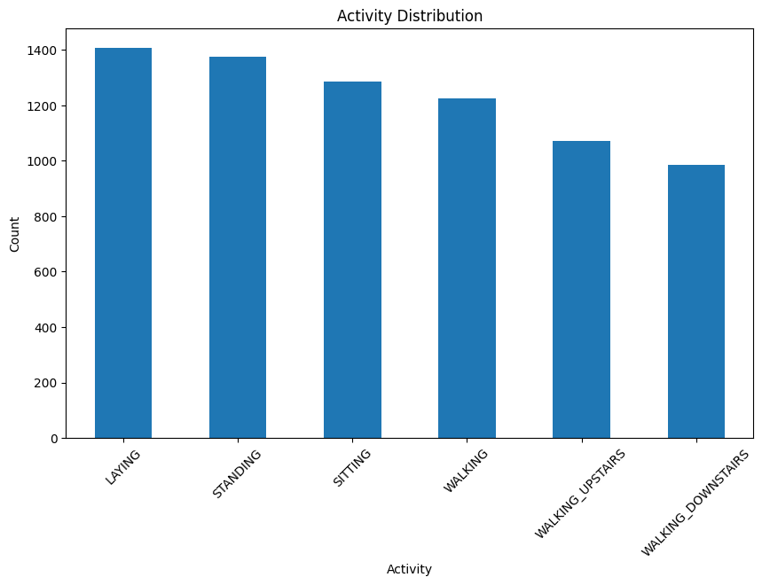
The obtained dataset has been randomly partitioned into two sets, where 70% of the volunteers was selected for generating the training data and 30% the test data.
The graph show the distribution of the activities in training data

Slide 6
Data Processing
Loading Data
Encoding Labels:
Convert string labels into integer indices for model compatibility.
Preprocessing Data:
Data Normalization : Z-Score

Slide 7
State-of-the-art models
State-of-the-art models for Human Activity Recognition (HAR) leverage advanced deep learning architectures to capture both spatial and temporal patterns in time series data. Convolutional Neural Networks (CNNs) are effective for extracting spatial features, while Recurrent Neural Networks (RNNs) and Long Short-Term Memory (LSTM) networks capture temporal dependencies. Temporal Convolutional Networks (TCNs) handle sequential data using causal convolutions, and attention mechanisms like Transformers use self-attention to capture long-range dependencies. Hybrid models, such as CNN-LSTM, combine CNNs and LSTMs to benefit from both spatial and temporal feature extraction, making them particularly effective for HAR tasks. These models represent the cutting edge in accurately recognizing human activities from sensor data

Slide 8
Models
ANN
CNN
CNN-LSTM
The HAR Model is a simple fully connected neural network with three layers. The input layer has 561 nodes, " "followed by two hidden layers with 256 and 128 nodes respectively, and an output layer with 6 nodes corresponding to the activity classes.
The HARCNN model is a convolutional neural network designed to capture spatial relationships in the sensor data. It consists of two convolutional layers followed by max-pooling layers, and two fully connected layers."
The HARCnnLstmModel combines convolutional layers with LSTM layers to capture both spatial and temporal " "relationships in the data. The convolutional layers process the input data, which is then passed to the LSTM " "layers to learn temporal dependencies.

Slide 9
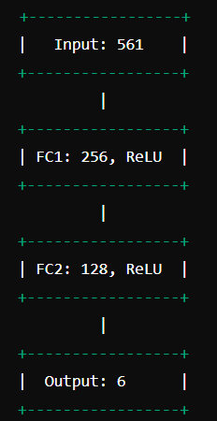
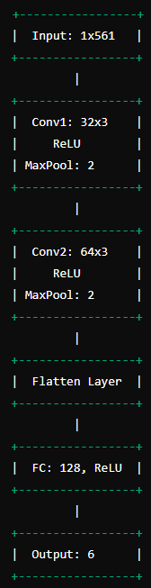
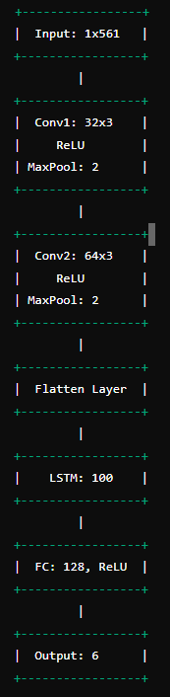

Slide 10
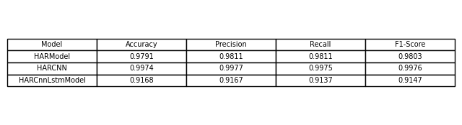
The performance metrics for the three models are presented below:

Slide 11
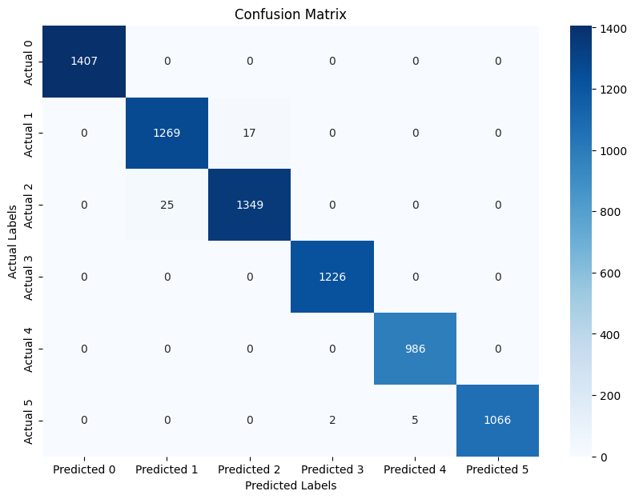
Confusion Matrix of Ann Model

Slide 12
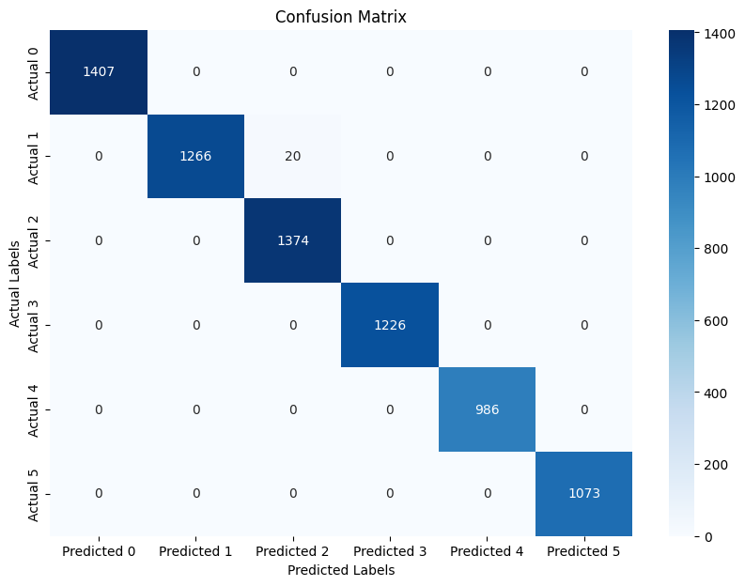
Confusion Matrix of Cnn Model

Slide 13
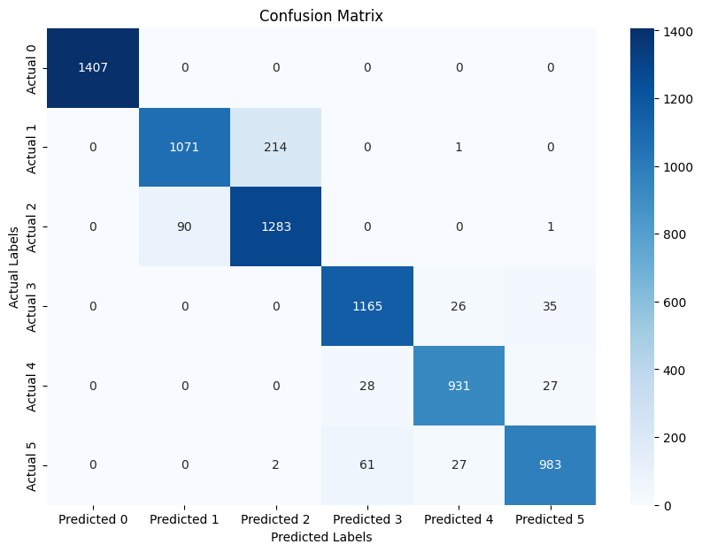
Confusion Matrix of CnnLstm Model

Slide 14
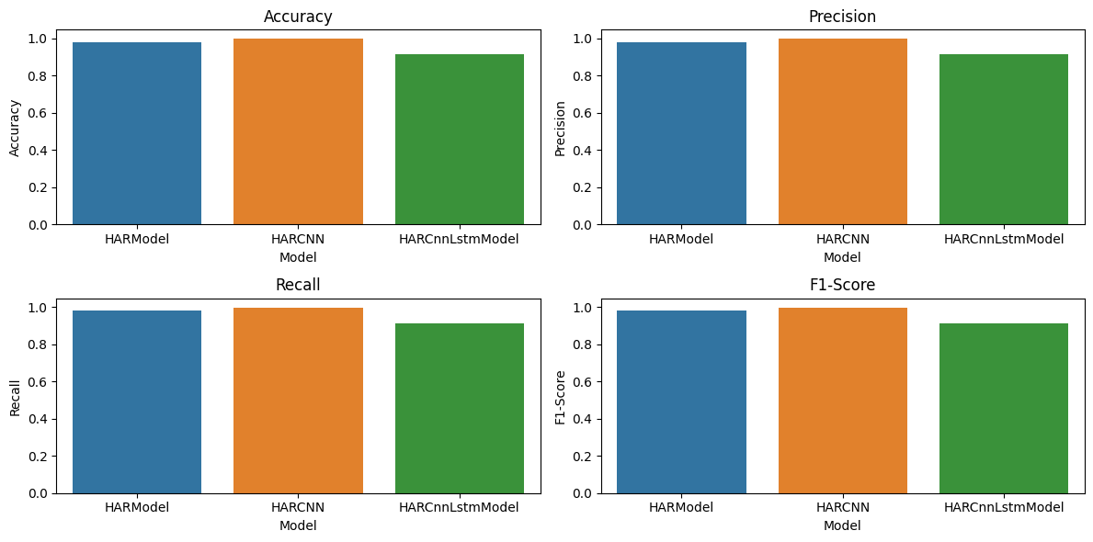
metrics

Slide 15
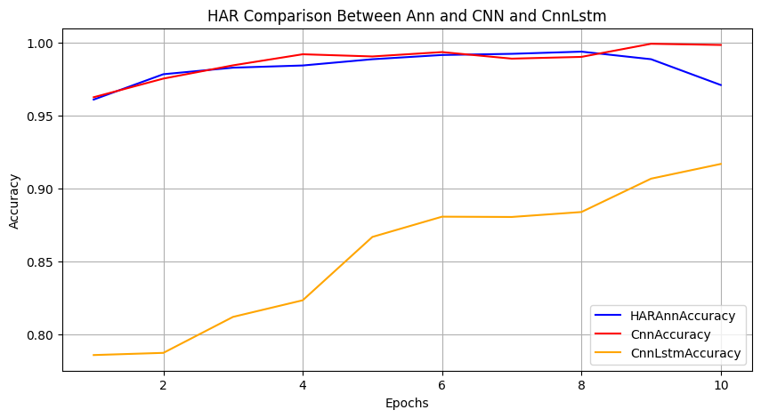

Slide 16

Dashboard

Slide 17
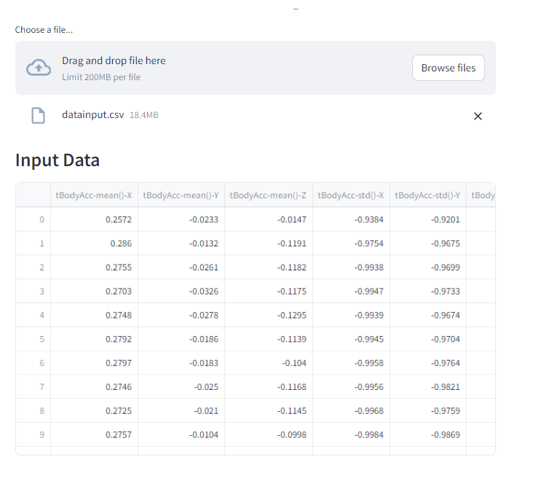

Slide 18
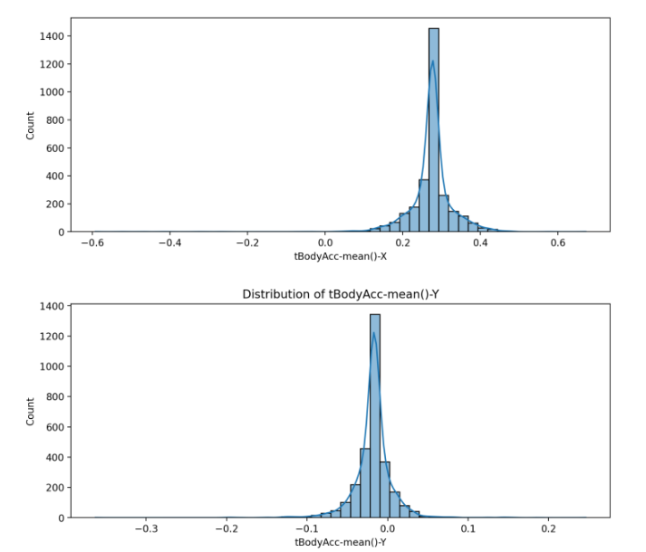
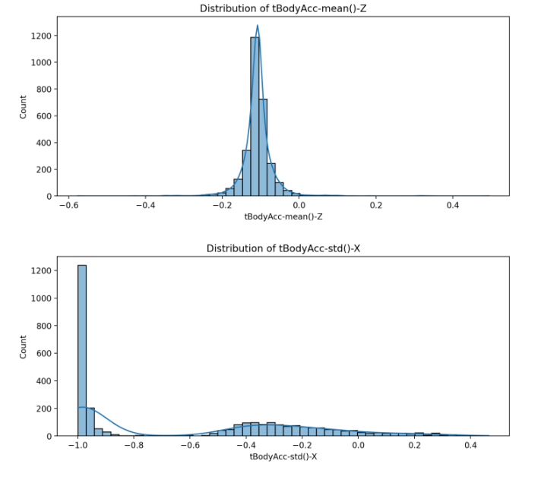
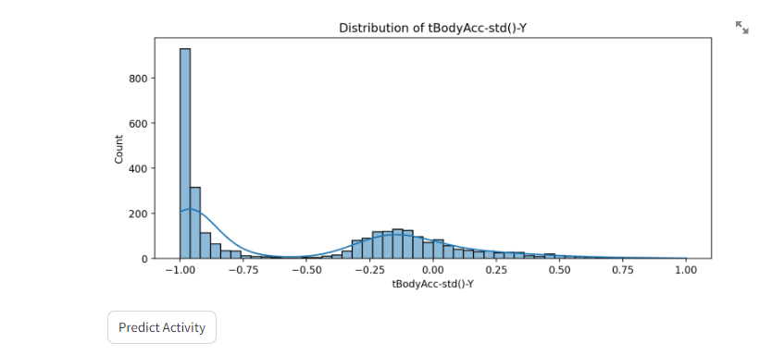

Slide 19
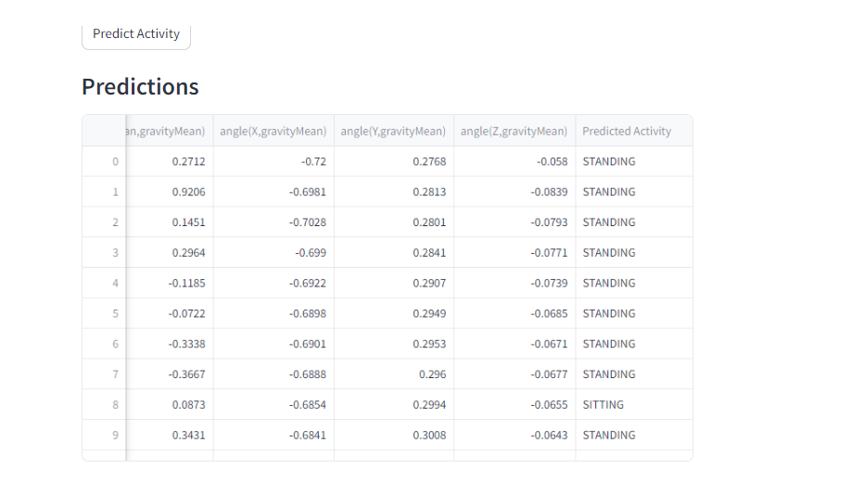

Slide 20
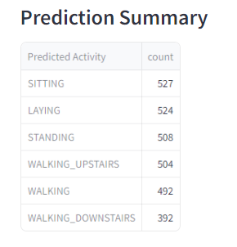
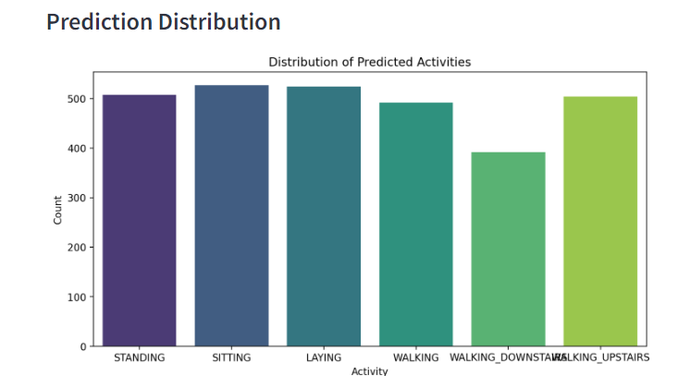

Slide 21

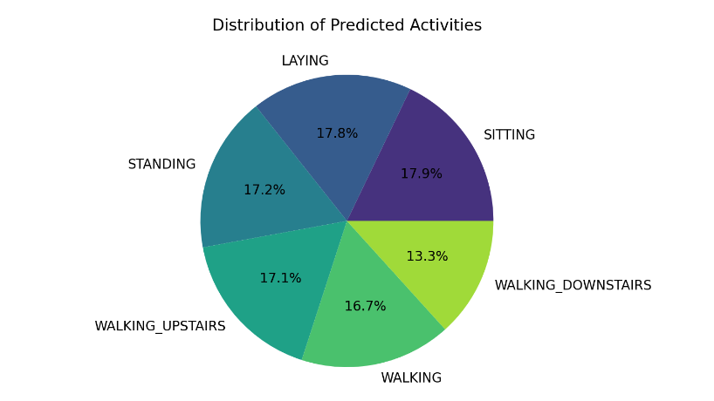

Slide 22






Tools and Environment
Environment for Training:
Data Analysis
For creating deep learning Models :
Statistical data visualization:
For deployment: Streamlit

Slide 23
Future Work
Investigate more advanced deep learning architectures.
Hyperparameter tuning.
Integration with real-time HAR systems.
Exploration of additional sensor data types.

Slide 24

Conclusion

Slide 25
Thank You
Prof.Federico De Guio Prof.Matteo Fossati

